Slide 1

DDST Denver Developmental Screening Test
Part 3 : Development Measurements
Third Stage
Dr. Moustafa Alshammari
Growth and Developments

Slide 2
Denver Developmental Screening Test (DDST-II)
Evaluates development for children 0-6 in four areas
  Personal-social
  Fine-motor
  Language
  Gross motor
Child’s mood must be typical for results to be valid (results may be altered if child is not feeling well, sedated)

Slide 3
The goals of DDST- II
The goals of DDST- II were to create standardized test in an easy, quick and simple to administer and interpret the test result according to the strength and weaknesses of the child. It is use to provide an early intervention to a child.

Slide 4
The goals of DDST- II
The purpose of DDST – II depend on the age of the child.
Newborn child – to detect if there is a neurological problem like cerebral palsy.
Infants – to identify nature of the possible problems for the early intervention.
Children – to delineate academic and social problems in order to give an early intervention

Slide 5
Denver Developmental Screening Test (DDST-II)
Provides a clinical impression on child’s overall development
Not a predictor of future development, not an IQ test
Used for noting problems, monitoring, and to base a referral for additional developmental testing

Slide 6
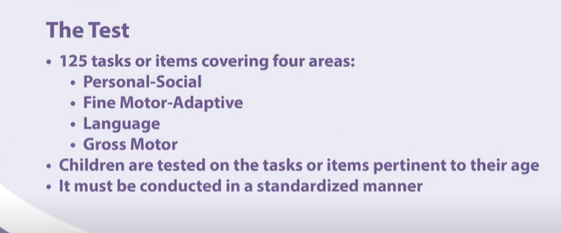

Slide 7
How to administer the DDST-II
It can be administer in a busy setting, day care center with or without parents with the present of the teachers, caregivers or who are very familiar to a child. Parents will be asked later if there is some information need for the assessment.

Slide 8
How to administer the DDST-II
It is designed to the children between birth and 6 years old.
It can be administer by anyone who is close to the child and can follow the direction of the DDST-II. But mostly the paraprofessional and the professional using this instrument .
Personal – Social; getting along with his or her mother going to the river caring his or her towel.
Fine Motor Skills; eye-hand coordination, tearing the papers.
Language: hearing, understanding, saying words
Gross Motor; sitting, walking, jumping, and others use the large muscles.

Slide 9
Cont.
A parent should be cautioned before administration that this is not a test of intelligence but of the child’s level of development.
The child’s inability to perform a task that most children of the same age can accomplish indicates a delay in that area.
Further evaluation is then needed to determine the reason for this delay.

Slide 10
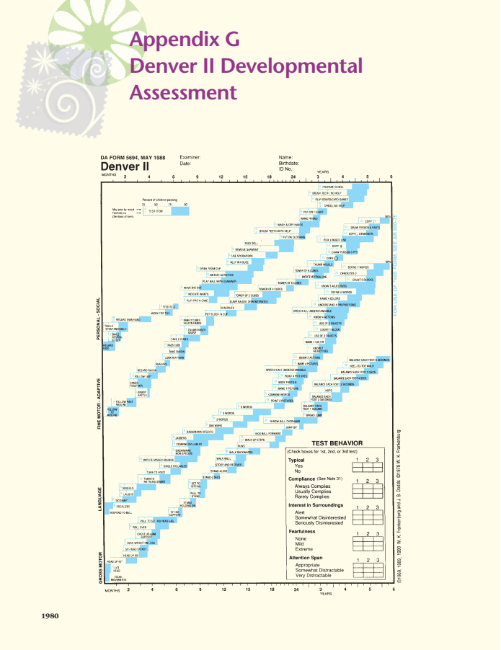
Denver II Developmental
Assessment

Slide 11
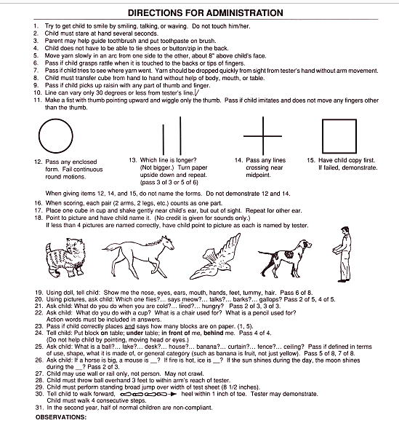
Denver II Developmental
Assessment

Slide 12
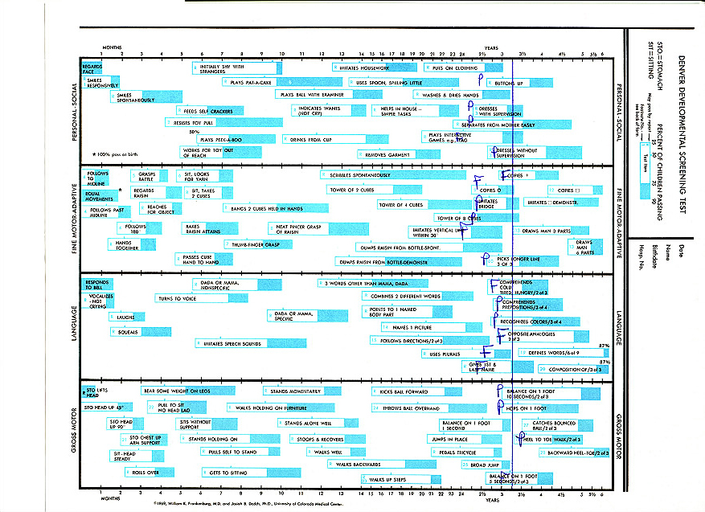

Slide 13
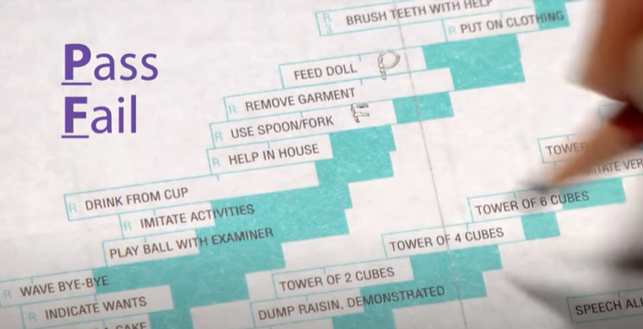

Slide 14
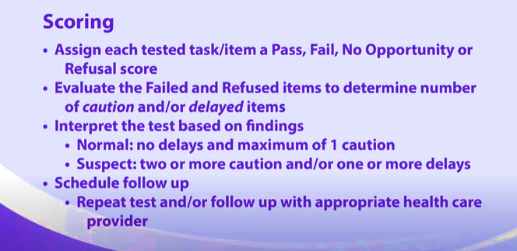
Notes:
🟡 Caution
A Caution is scored when:
The child fails or refuses an item
AND the age line falls between the 75th and 90th percentile
This means:
75–90% of children this age can already perform this task.
🔴 Delay
A Delay is scored when:
The child fails or refuses
AND the age line falls completely to the right of the 90th percentile
This means:
More than 90% of children this age can do this task
NormalNo delays AND maximum of 1 caution
Suspect≥2 cautions AND/OR ≥1 delay
UntestableRefusals on ≥1 item completely left of age line or ≥2 items intersected by age line

Slide 15
Thank you
رمز الصف

